Slide 1
Detecting Market Manipulation: Forecasting Pump and Dump Schemes in Cryptocurrency
Presentation : I
Date : 2024/09/26
Ajeet Kumar Rai
Department of Applied Mathematics and Statistics, Stony Brook University
ajeetkumar.rai@stonybrook.edu

Slide 2
INTRODUCTION
The project aims to predict pump and dump events in cryptocurrency markets.
Manipulators artificially increase prices (pump) and then sell (dump), causing prices to fall.
The goal is to detect early signs of such manipulation to protect investors from potential losses.
The Securities and Exchange Board of India (Sebi) has slapped a fine of Rs 7.75 crore on 11 individuals for allegedly operating a 'pump and dump' scheme in the scrip of Svarnim Trade Udyog.
An Instagram post a few months ago that encouraged people to invest in a particular stock, and the comments were filled with warnings about a potential pump-and-dump scheme.

Slide 3
PUMP AND DUMP
Initial Price: The price of cryptocurrencies with low volume starts at $100.
Pump Phase: A group of people buy a large amount of the asset and promote it on social media.
Price Surge: Due to the increased demand, the price rapidly increases from $100 to $110.
Dump Phase: When the price reaches $110 the manipulators sell their stake.
Price Crash: After the sell-off, the panic causes the price to rapidly drop to $90.
Late Investors: Those who bought at $110 suffered losses.
Outcome: The manipulator profits, while investors who invest late are stuck with the devalued asset.

Slide 4
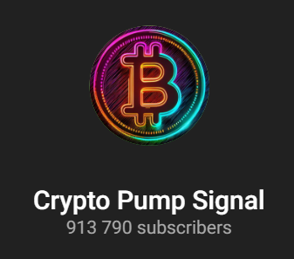
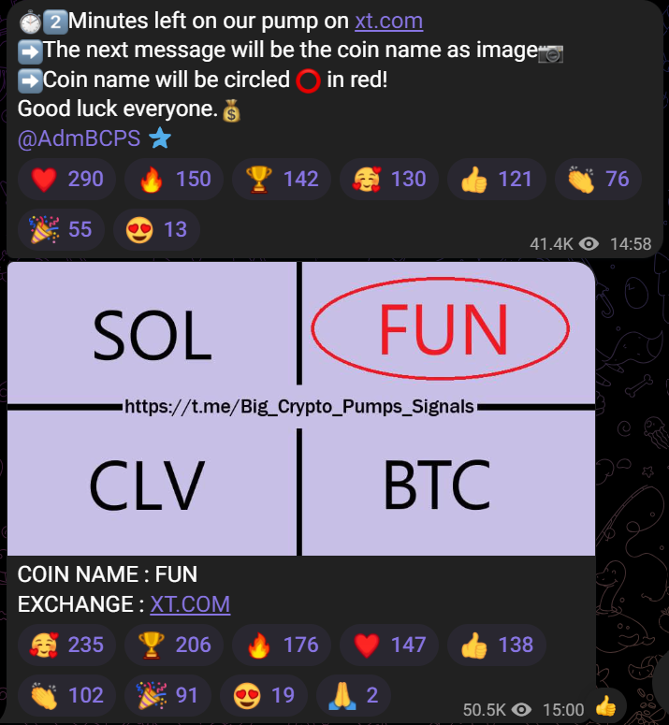
RECENT PUMP- DUMP
Pump and Dump event on 23rd Sept. 2024 at 15:00 PM

Slide 5
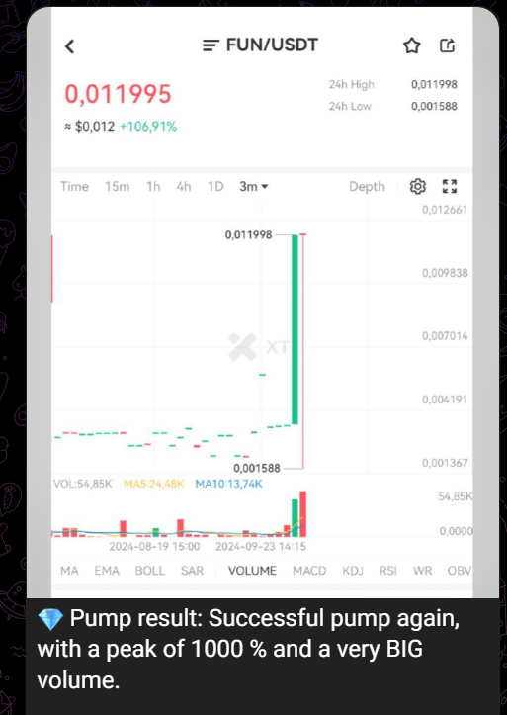
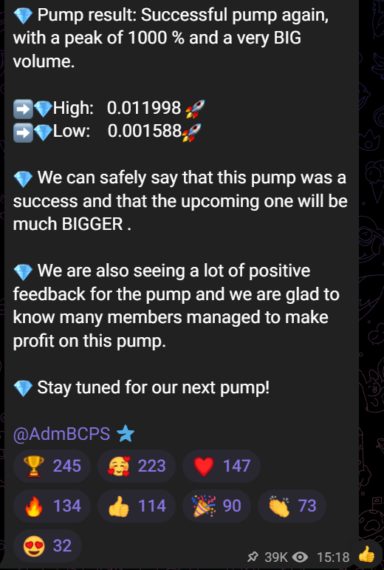
RECENT PUMP- DUMP

Slide 6
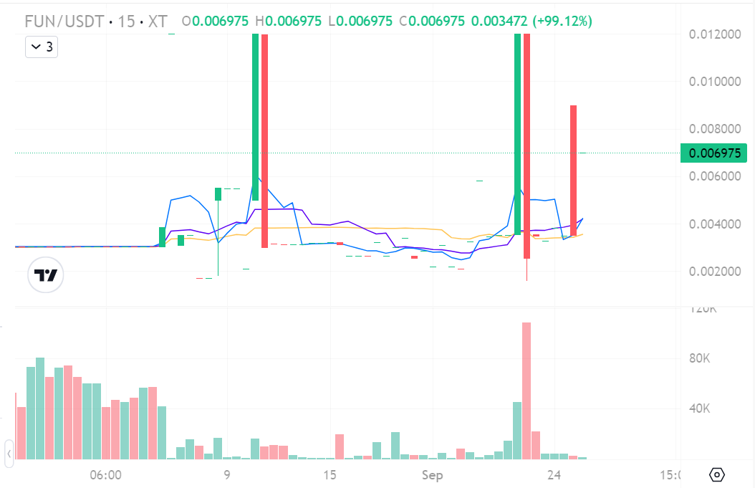
RECENT PUMP- DUMP

Slide 7
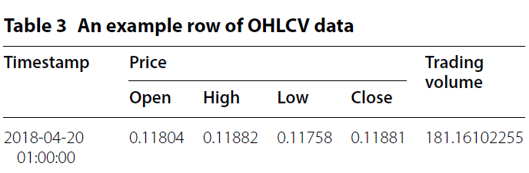
LITERATURE REVIEW - I
Article: To the moon: defining and detecting cryptocurrency pump and dumps.
Authors: Josh Kamps and Bennett Kleinberg.
Techniques from anomaly detection research are utilized to locate points of anomalous trading activity in order to flag potential pump-and-dump activity.
The CCXT (Ccxt 2018) library was used, which provides access to data from various cryptocurrency exchanges using Python.

Slide 8
LITERATURE REVIEW – I
Unsupervised anomaly detection focus, as no labeled training data is currently available (very hard to collect) for cryptocurrency pump-and-dump schemes.
Conditional anomalies consider contextual information about the setting.
This is described through indicator variables, of which the values may be directly indicative of an anomaly, and environment variables, whose variables are not directly indicative of an anomaly.

Slide 9
LITERATURE REVIEW – I
Price: If the high price at any given point is greater than the computed anomaly threshold for that point, then the point is determined to be anomalous. The anomaly threshold is computed using a given percentage increase a lag factor γ and the simple moving average μγ (x) over the closing price.
Volume : The volume anomaly is defined almost identically to the above, except with the moving average
Low market cap: The market cap of a coin is defined as its price times the supply, and represents a way of judging the popularity, or size, of a coin.

Slide 10
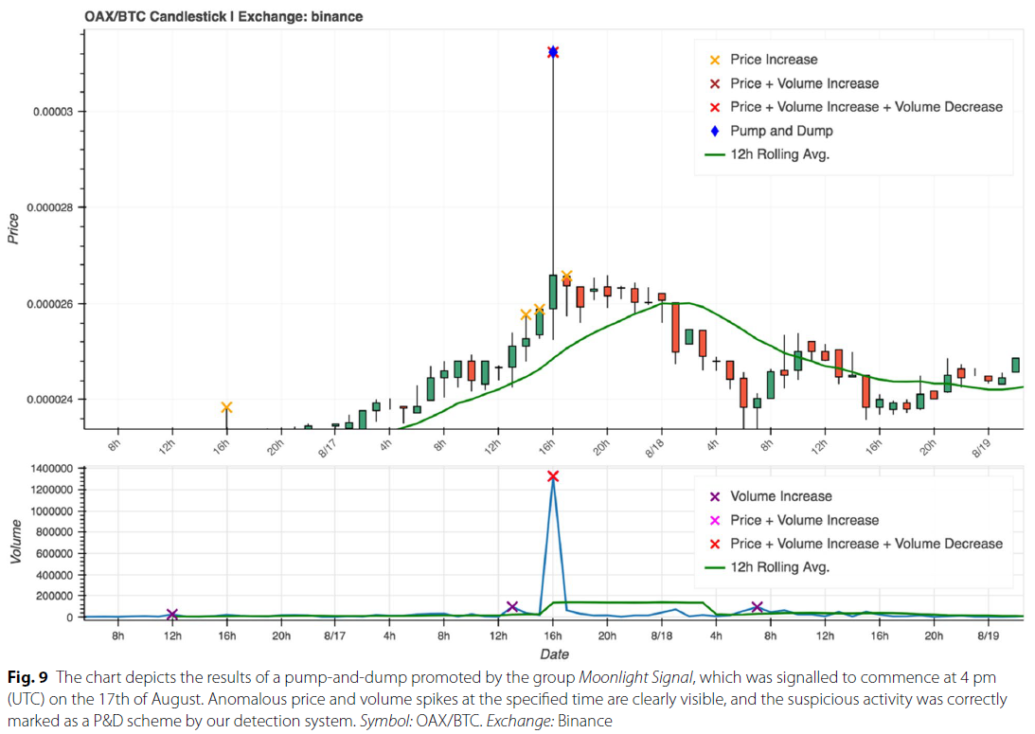
LITERATURE REVIEW – I

Slide 11
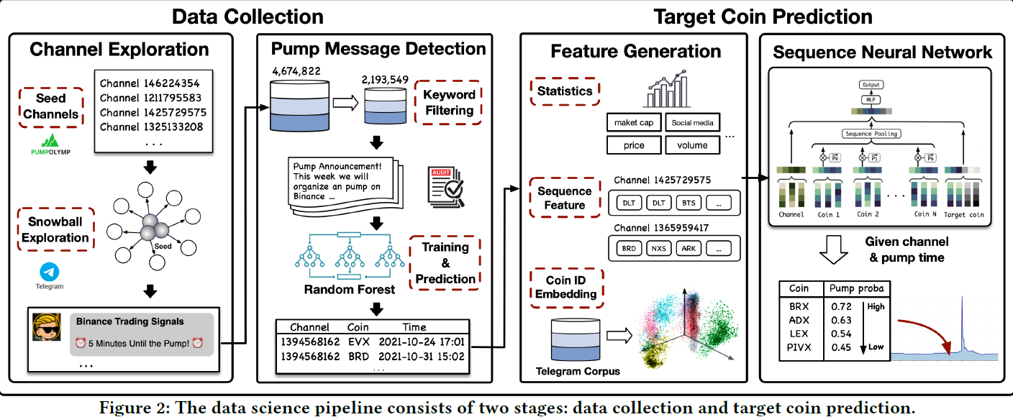
Literature Review II
Article : Sequence-Based Target Coin Prediction for Cryptocurrency Pump-and-Dump
Authors: Sihao Hu,Zhen Zhang,Shengliang Lu,Bingsheng He, and Zhao Li

Slide 12
CHANNEL EXPLORATION
Total 1,142 telegram channels organizing pump-dump events collected from PumpOlymp.
Raw data (4,674,822 telegram messages) collected through telegram API.
Snowball Exploration performed to detect similar channels.
Total of 4,674,822 messages that are posted on these 715 active channels between Jan. 1, 2019, and Jan. 13, 2022.

Slide 13
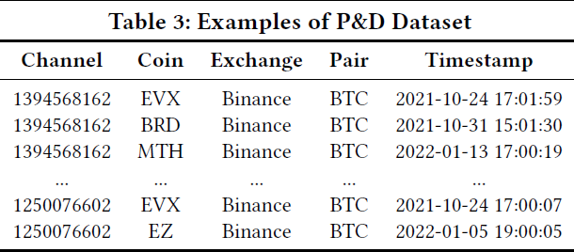
PUMP MESSAGE DETECTION
Keywords such as "pump," "target," "hold," "sell," etc. were used to select 2,193,549 messages out of 4,674,822 messages.
TF-IDF were used to for encoding these messages,
Random Forest model implemented on sample of 5000 data to detect pump-dump events with AUC 0.994

Slide 14
FEATURE GENERATION
Channel : channel_id and subscriber_num
Target coin : coin_id and stable statistics (market_cap, price, volume, Alex_rank, Twitter_follower, Reddit_subscriber, etc.)
Sequence : market movement signals (price, return, volume, trade_cnt, etc.) within (𝑥+1) hour to 1 hour prior to the pump time with varing time window ranges (𝑥 = [1, 3, 6, 12, 24, 48, 60, 72]).

Slide 15
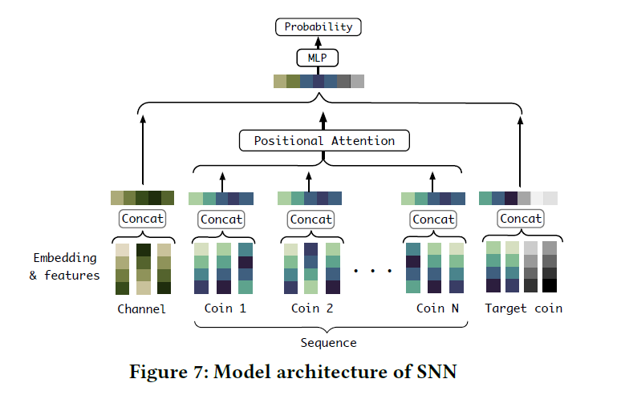
Sequence Neural Network (SNN)

Slide 16
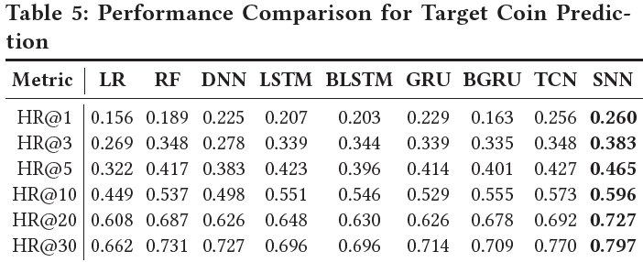
RESULTS

Slide 17
PLAN OF ACTION
Retrieve the results from literature review II.
Data Collection: Currently, 3 years of data have been used, and we will extend it for the larger dataset.
Feature Engineering: Many possible features such as Coin rating, isPenny, channel region, etc, can be included.
Models: Instead of SSN, we will look for other models or methodology as well.
Predictions: We will not only predict the target coin but also try to predict time interval of next pump-dump event and expected gain or loss.

Slide 18
Objective
To detect market manipulation and returns.
Relevance and importance
Investment Return: If we buy coins with higher pump probability and ignore others, the higher the returns.
Protect Investor : Protecting investor from potential losses.
Team skills & expertise
Skills: Finance, Programming, Data gathering & Database, ML/AI, and Research.
Experiences: Several years of experience in the industry.
Team Member : Ajeet Rai

Slide 19
REFERENCES
Telethon api. https://docs.telethon.dev
J. Hamrick, F. Rouhi, A. Mukherjee, A. Feder, N. Gandal, T. Moore, and M. Vasek. The economics of cryptocurrency pump and dump schemes. Available at SSRN3310307, 2018.
M. La Morgia, A. Mei, F. Sassi, and J. Stefa. Pump and dumps in the bitcoin era: Real time detection of cryptocurrency market manipulations. In 2020 29th International Conference on Computer Communications and Networks (ICCCN), pages 1–9. IEEE, 2020.
Ccxt. (2018). ccxt/ccxt. Retrieved from https ://githu b.com/ccxt/ccxt.
https://github.com/Bayi-Hu/Pump-and-Dump-Detection-on-Cryptocurrency/tree/master
A. Dhawan and T. J. Putnin,š. A new wolf in town? pump-and-dump manipulation in cryptocurrency markets. Pump-and-Dump Manipulation in Cryptocurrency Markets (November 17, 2020), 2020.

Slide 20
THANK YOU !

